Slide 1
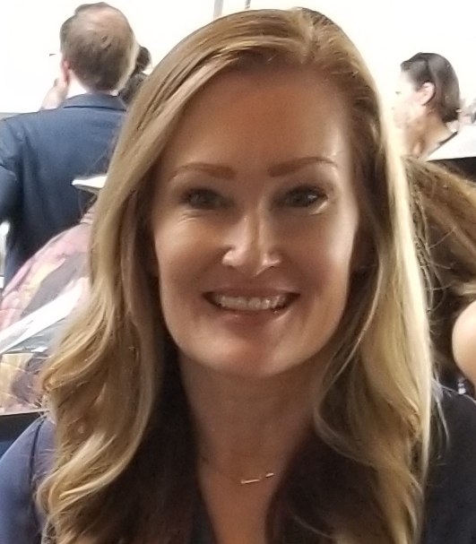
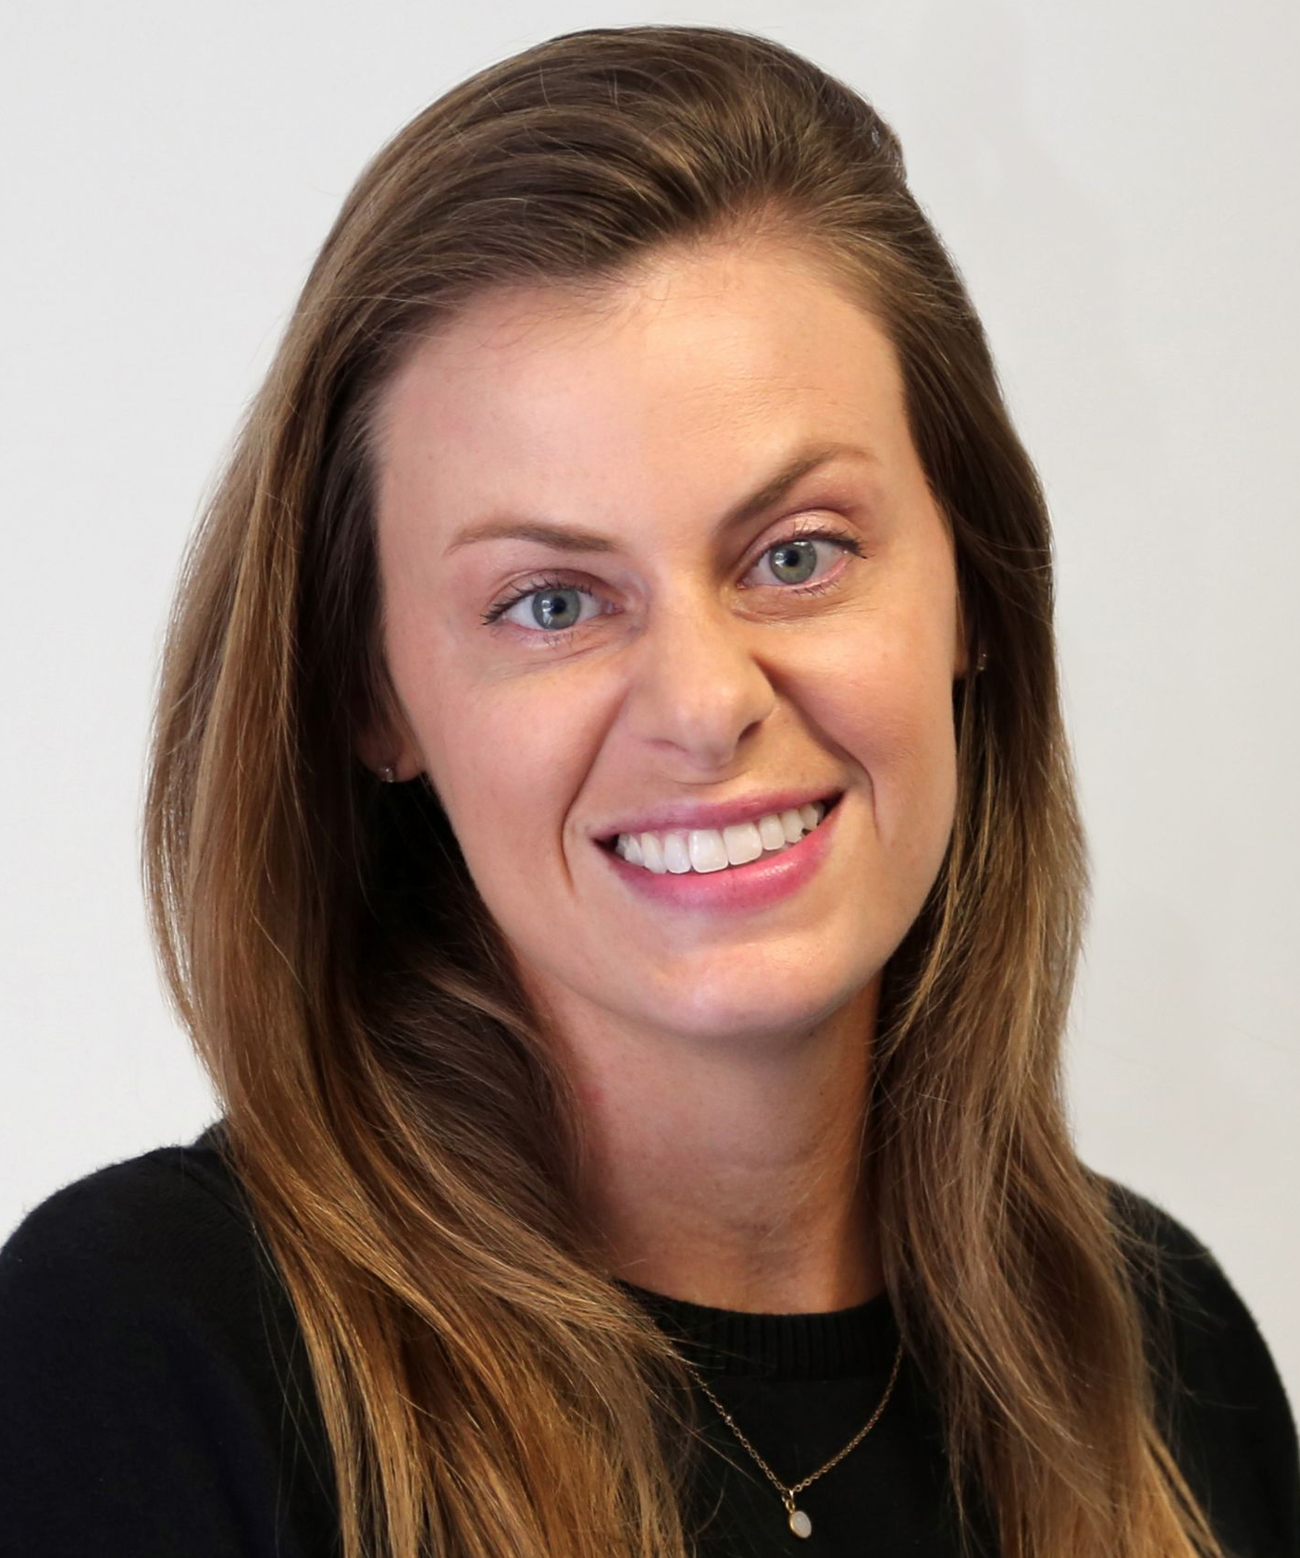
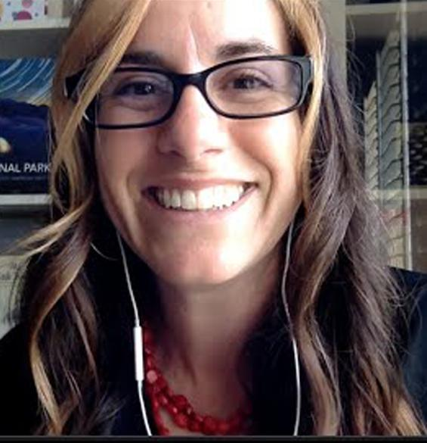
CCCD Online Proctoring
Professor Tobi West
MSBA- Information Assurance
Pilot - 4 classes
126 students
Department Chair CIS/CST/CYBR/DGA
Professor Stacey Smith
MA- Economics
Pilot - 3 classes
100+ students
Department Chair Economics / Business
Professor Elizabeth Horan
MLIS, MSIDT
Pilot- Library Workshops
748 students (*246)
Department Chair
Library
Academic Senate
Task Force

Slide 2
CCCD Online Proctoring
Federal Code of Regulation Citation
34 C.F.R. § 602.17(g) requires accrediting agencies that approve institutions that offer distance education or correspondence education to have processes in place through which the institution establishes that the student who registers in a distance education or correspondence education course or program is the same student who participates in and completes the course or program and receives the academic credit.
AP 4105 Distance Education
Consistent with federal regulations pertaining to federal financial aid eligibility, the District must authenticate or verify that the student who registers in a distance education courses is the same student who participates in and completes the course or program and receives the academic credit. The District will provide to each student at the time of registration, a statement of the process in place to protect student privacy.
The District shall utilize secure credentialing/login and password to authenticate or verify the student’s identity. In addition, proctored examinations will be utilized, as applicable.

Slide 3
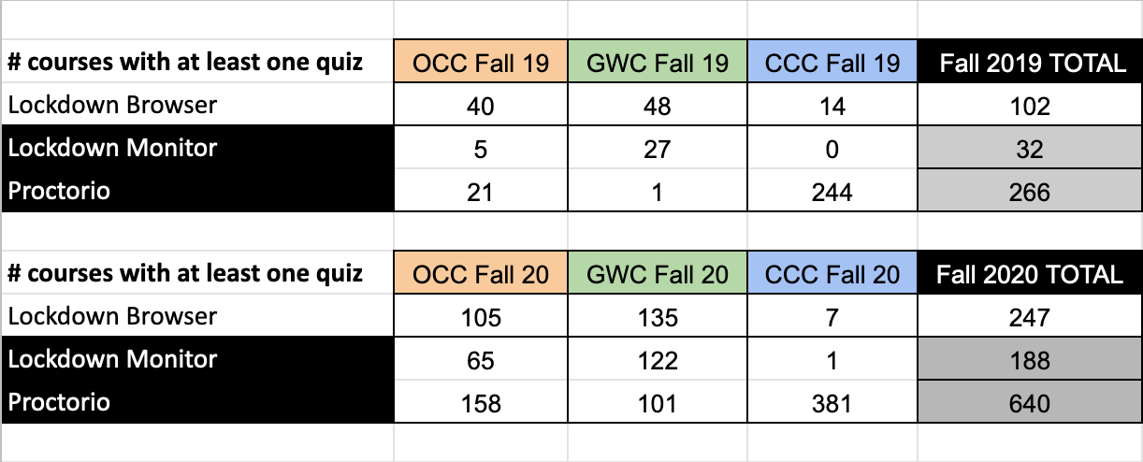
CCCD Online Proctoring
Stats provided by Rupa Saran via email 3/10/2021

Slide 4
Student Experience - Install
1. Student is in Canvas - needs to take a quiz
2. Student needs to download Respondus
2. Student needs to use CHROME web browser
3. Student installs Respondus on computer
3. Student installs CHROME Proctorio Extension
4. Student quits all computer programs
4. Student goes to quiz in Canvas and starts quiz
5. Student opens Respondus on computer
6. Student logs into Canvas (must have OTP)
7. Student goes to quiz in Canvas and starts quiz

Slide 5
Student Experience - 2nd Quiz
1. Student is in Canvas - needs to take a quiz
2. Student quits all computer programs
2. Student goes to quiz in Canvas and starts quiz
3. Student opens Respondus on computer
4. Student logs into Canvas (must have OTP)
5. Student goes to quiz in Canvas and starts quiz
AFTER Quiz - Student quits Respondus and logs back into Canvas..

Slide 6
Student Experience - Chromebooks
INSTALL - Personal Computer …..
1. Student is in Canvas - needs to take a quiz
2. Student needs to download Respondus
3. Chromebook will not download Respondus
4. Student needs to install Virtual Desktop
5. Student goes to COAST Info Services - Instructional Support webpage
6. Student downloads “Using Virtual Desktop” PDF
7. Student searches “vmware horizon client download”
8. Student goes to website for “vmware horizon client download”
9. Student finds operating system
10. Student downloads Virtual Desktop
11. Student starts Virtual Desktop installation (lots of steps here)
12. Student must restart computer

Slide 7
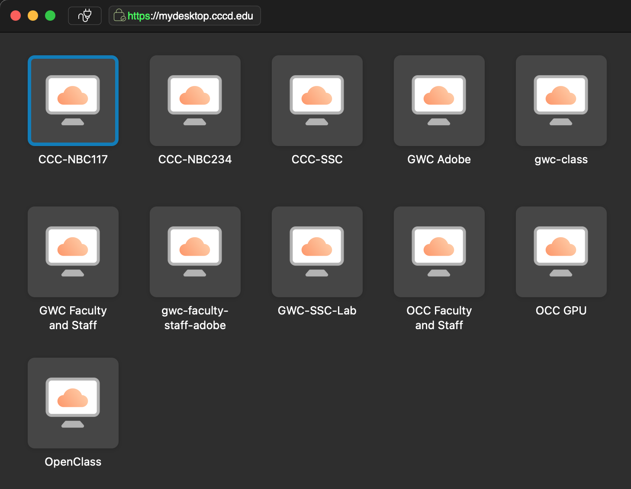
Student Experience - Chromebooks
Respondus in Virtual Desktop …..
1. Student is in Canvas - needs to take a quiz
2. Student needs to open Virtual Desktop
3. Student needs to login to Virtual Desktop (OTP)
4. Student needs to “select a desktop”
5. Student clicks Respondus icon
6. Student logs in to Canvas (OTP)
7. Student goes to Canvas class
8. Student finds and takes Quiz
9. Student exits Respondus
10. Student quits Virtual Desktop
11. Student logs back in to Canvas

Slide 8
CCCD Online Proctoring
2 Reasons
Student Verification
Prevent Cheating

Slide 9
CCCD Online Proctoring
Prevent Cheating
X
=
Chromebooks

Slide 10
CCCD Online Proctoring
Hard to Compare
Recording Options:
Lockdown Options:
Verification Options:
Recording Options:
1. Record video
1. Force full screen
1. Verify video
1. Record video (Lockdown Monitor)
2. Record audio
2. Only one screen
2. Verify audio
Verification Options:
3. Record screen
3. Disable new tabs
3. Verify Desktop
4. Record web traffic
4. Close open tabs
4. Verify ID
1. Verify ID (Lockdown Monitor)
5. Record room
5. Disable printing
5. Verify signature
6. Disable clipboard
6. Verify login
Behavior Settings
7. Clear cache
8. Disable right click
In Quiz tools
1. Recommended
Lockdown Options:
2. Lenient
9. Prevent re-entry
1. Calculator
1. Lockdown Browser
(*except Chromebooks)
3. Moderate
2. Whiteboard
4. Group exam
5. Open note
6. Custom

Slide 11
CCCD Online Proctoring
Hard to Compare
Technical Support
Student Help:
No in APP support once quiz starts.
Student can submit help ticket (24 hour turn around M-F).
Student Help:
24/7 phone and chat support. In “app” / quiz chat support (24/7).
Faculty Support:
24/7 phone and chat support
Faculty self support - Investigate technology issues (battery issues, Canvas issues, network issues), IP identification, screen recording, exam sensitivity settings (open-note), etc. Faculty able to investigate academic dishonesty issues and submit “evidence” to Dean of Students from Proctorio.
Faculty Support:
Submit request to District IT email - 2 week turn-around

Slide 12
CCCD Online Proctoring
Outcome
Proctorio is the more effective tool..
Federal Code of Regulation Citation
34 C.F.R. § 602.17(g) requires accrediting agencies that approve institutions that offer distance education or correspondence education to have processes in place through which the institution establishes that the student who registers in a distance education or correspondence education course or program is the same student who participates in and completes the course or program and receives the academic credit.
AP 4105 Distance Education
Consistent with federal regulations pertaining to federal financial aid eligibility, the District must authenticate or verify that the student who registers in a distance education courses is the same student who participates in and completes the course or program and receives the academic credit. The District will provide to each student at the time of registration, a statement of the process in place to protect student privacy.
The District shall utilize secure credentialing/login and password to authenticate or verify the student’s identity. In addition, proctored examinations will be utilized, as applicable.

Slide 13
CCCD Online Proctoring
Outcome
For Faculty:
1.Educate Faculty / Staff about Respondus so they can help students or send students to effective technical support
For Students:
1.Create Respondus Virtual Desktop (Chromebook)
2.Train / encourage faculty to use Respondus Lockdown Monitor to verify student ID to be in compliance with Federal Code and AP4150
2.Create District directions for Respondus
3.Provide District technical support for Respondus
4.Educate Faculty / Staff about Respondus so they can help students or send students to effective technical support
3.Implement an effective workflow with IT to view suspected cases of academic dishonesty and to include videos if a report is filed

Slide 14
CCCD Online Proctoring
Professor Tobi West
MSBA- Information Assurance
Pilot - 4 classes
126 students
Department Chair CIS/CST/CYBR/DGA
Professor Stacey Smith
MA- Economics
Pilot - 3 classes
100+ students
Department Chair Economics / Business
Professor Elizabeth Horan
MLIS, MSIDT
Pilot- Library Workshops
748 students (*246)
Department Chair
Library
Academic Senate
Task Force

